Slide 1


Old Dominion University
CS 410 - Team Bronze
Formal Design Presentation
December 5, 2019

Slide 2
Table of Contents
Feasibility
Team Bronze……………………………………….……….…......……….3
Problem Background…………………………………….…...…….4-6
The Problem…………………..……………...………...…...…....…....7-8
Current Process Flow…………...………………….…...…....……….9
Our Solution………………….…...………………….….….…...…10-11
Customers, Users, and Stakeholders……………….…...…....12
Solution Process Flow……..………………….……………..…...….13
Design
User Roles……………………………………………..……………..…....14
Major Functional Component Diagram (MFCD)....….....15
Dev Tools, Hardware and Software Needs……………..….16
Development Model…………………………………………………..17
Work Breakdown Structure (WBS) Overview…………...18
User Interface………………………………………...….…...……19-21
GUI Mockup…………………………………….…...…….……..…22-28
Algorithm…………………………………….……………….....……29-33
Design
Database…………………………………….…………………..……34-35
External Interface…………………………………….……….....……36
Testing…………………………………….…...……...…….………..…..…37
Risk Matrix and Mitigation Strategies……………….....38-39
Sprint Breakout……………………...……………………….…...….…40
What our Solution will NOT do……………………….…...….…41
Competition matrix………………………………………...….…......42
Benefits to Customer Base……………………………..…….…...43
Conclusion…………………………………….…...……..…….…...……44
Questions…………………………………….….…….…..…….…...……45
References/Appendices
References..……………………………………………….......…….46-47
Glossary…....………………………………………………....…...….48-49
Appendix A - User Stories…………………………...…….….50-53
Appendix B - Developer Stories...…………………………54-56
CS 410 - Team Bronze | Fall 2019 | Old Dominion University

Slide 3
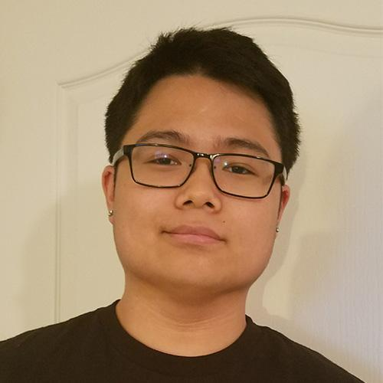

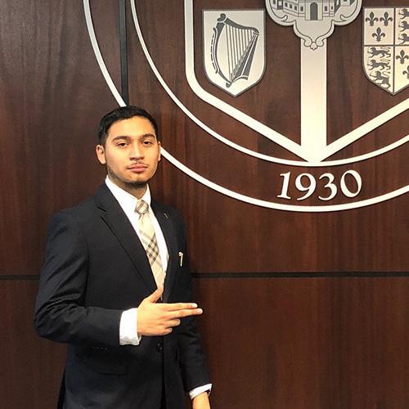
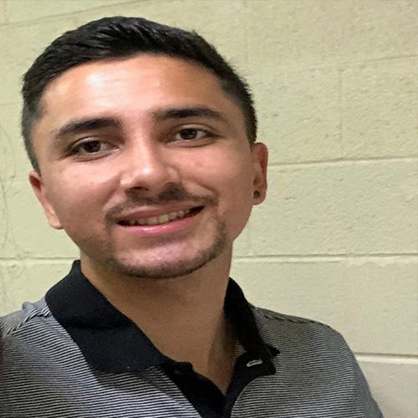

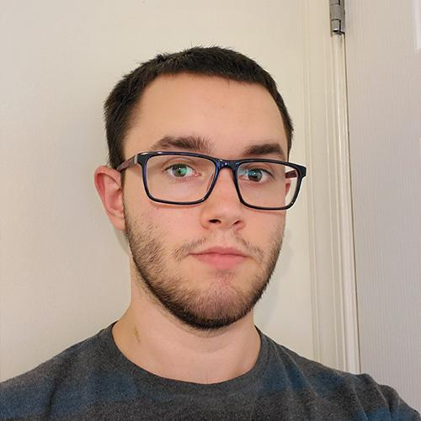

Meet the Team!
Kevin Fang
Team Lead
April McIntire
UI/UX Designer
Rodolfo Monterroso
Webmaster
Roshan Ghimire
Developer/Quality Assurance
Josten Asercion
Game Developer
Tim Novak
Lead Back-End Developer
Shane Shifflett
Webmaster/Back-End Developer
CS 410 - Team Bronze | Fall 2019 | Old Dominion University

Slide 4
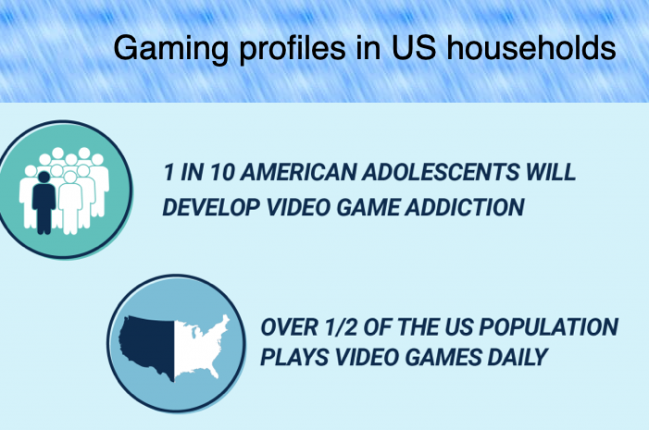
Problem Background
The World Health Organization officially claimed gaming disorder as a disease in 2018.⁹
To be diagnosed with gaming disorder, a person must show 12 months of severe symptoms, including prioritizing gaming over work, education and social relationships.⁹
64% of the U.S. Population are gamers.⁶
Globally, 75 million people suffer from gaming disorder.⁹
77% of Americans are not meeting the recommended amount of exercise by the U.S. Department of Health and Human Services ²
CS 410 - Team Bronze | Fall 2019 | Old Dominion University
Notes:
Was trying to add in-text citation, but could not find quote for
77% of Americans are not meeting the recommended amount of exercise by the U.S. Department of Health and Human Services
Either get rid or find a quote similar that we can reference
https://health.gov/dietaryguidelines/2015/guidelines/appendix-1/

Slide 5
Negative Effects of Gaming Disorder
Social isolation ¹⁴
Emotional effects ¹⁴
Decrease in mental performance in education or other activities ¹⁴
Health issues
Increased risk of obesity ¹⁴
Headaches, backaches ⁶
Development of carpal tunnel syndrome ⁶
CS 410 - Team Bronze | Fall 2019 | Old Dominion University
Notes:
Add references
Add more health issues other than obesity as well as issues that can occur because of obesity such as high blood pressure
Effect of sedentary lifestyle for video game addicts

Slide 6
Who is affected?
94% of males and 6% of females represent the gender breakdown for gaming disorder.⁶
Males between the ages of 18-24 are most at risk for gaming addiction.⁶
Parents, spouses, and loved ones.
CS 410 - Team Bronze | Fall 2019 | Old Dominion University

Slide 7
Problem Statement
Gaming disorder disrupts normal life activities and causes important aspects of life to be neglected, such as maintaining a healthy dose of physical activity. The combination of video gaming and a lack of physical exercise leads to health concerns such as weight gain, poor posture, and an increased risk of type 2 diabetes in America's population.¹⁴
CS 410 - Team Bronze | Fall 2019 | Old Dominion University
Notes:
Changed correlation to “Often, the combination “, see about adding a citation showing correlation of video gaming, lack of exercise leads to health concerns - Kevin.

Slide 8
Problem Characteristics
Those with gaming disorder don’t find exercise as enjoyable as video games because of a lack of instant gratification.
For those with video game addiction, commitment to activities other than video games is difficult.¹⁴
Those with video game addiction find it unpleasant to leave their comfort area (gaming area).¹⁵
Those with a video game addiction tend to practice poor dietary habits.
CS 410 - Team Bronze | Fall 2019 | Old Dominion University
Notes:
Add references - no references that directly addressed the characteristics. If there were indirect relations then it would be added.

Slide 9
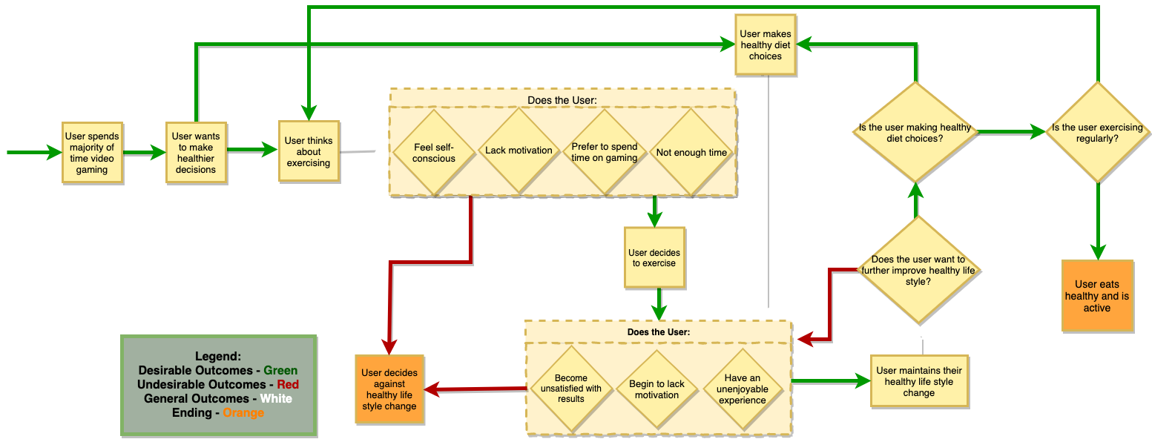
Current Process Flow
CS 410 - Team Bronze | Fall 2019 | Old Dominion University
Notes:
Add a start and end.
Ensure that clear outcomes occur instead of an infinite loop
change process flow to show an end outcome and how the user gets to the end without the app
Tie in benefits of outcomes - at the end - The User eats healthy and is active.
Today

Slide 10
Solution Statement
War of Brawns is a mobile application that focuses on engaging video gamers in a fantasy Role-Playing Game (RPG)⁵ where the storyline and character progression relies solely on the user’s physical activity. This will help users to incorporate healthy diet and exercise habits into their lifestyle that is being neglected due to video game addiction.
CS 410 - Team Bronze | Fall 2019 | Old Dominion University
Notes:
More detail about why the fantasy theme was chosen and is it popular?
Found this quote “The most addictive video games include massively multiplayer online games (MMOs) and role-playing games (RPGs).” in reference 5. Could be useful for argument why RPG theme was chosen.

Slide 11
Solution Characteristics
Sidetracks the long term gratification by offering instant gratification through in-game rewards and character progression.
Enforces commitment through the video game addiction. ¹
Trackers use biometrics to ensure physical activity.
Offers a variety of challenges such as gym or home workouts that can be shown based on users preference.
Application will include a workout guide for the user to understand proper form.
Track daily calorie intake through a diet journal.
Application will record progress towards goal weight through a line graph.
Offers interactive gameplay
CS 410 - Team Bronze | Fall 2019 | Old Dominion University
Notes:
Changed “short term” to “instant” because of direct relation to rewards and progression.
Go back over the solution characteristics and what the solution will not do and compare and contrast, so that all components of the app will be covered and discuss where to put missing details.
Instant Gratifcation:
leaderboard, daily streaks, and medals for accomplishment in solution characteristics.
in-game rewards and progression
combat system requires progression from user
swords, armor, etc
Stat increases
If we present again, then explain more of what the instant gratification is to the user and the designer.
If we present again, then explain that even though other applications have this feature, but we want these features to be in one whole application
Game will include “workout tutorials” in the workout challenges menu which will show general form
Put in Solution Characteristics or solution flow(?)Input information about this exercise guide into the solution characteristics and competition matrix

Slide 12
What our Solution will NOT do
Will not cure game addiction or take the place of gaming disorder therapy
Make users eat healthier
Replace routine exercise as best method for maintaining healthy lifestyle
Be effective for gamers who “spoof” the exercise challenges
Provide medical advice
CS 410 - Team Bronze | Fall 2019 | Old Dominion University
Notes:
Key Points: won’t cure game addiction, won’t make users eat healthier, won’t replace proper diet and routine exercise as the best method for living a healthy life, won’t be effective for gamers who spoof (or fake) the exercise challenges, won’t provide proper medical advice to users, users should always consult their physician about changes in diet or exercise when they have concerns.

Slide 13
Customers, Users, and Stakeholders
Users/Customers
Game Addicts
Gamers (not necessarily addicts)
Exercise Enthusiasts
Stakeholders
Family and friends of game addicts
Gyms
Gold’s Gym, Planet Fitness, etc.
Personal Trainers
CS 410 - Team Bronze | Fall 2019 | Old Dominion University

Slide 14
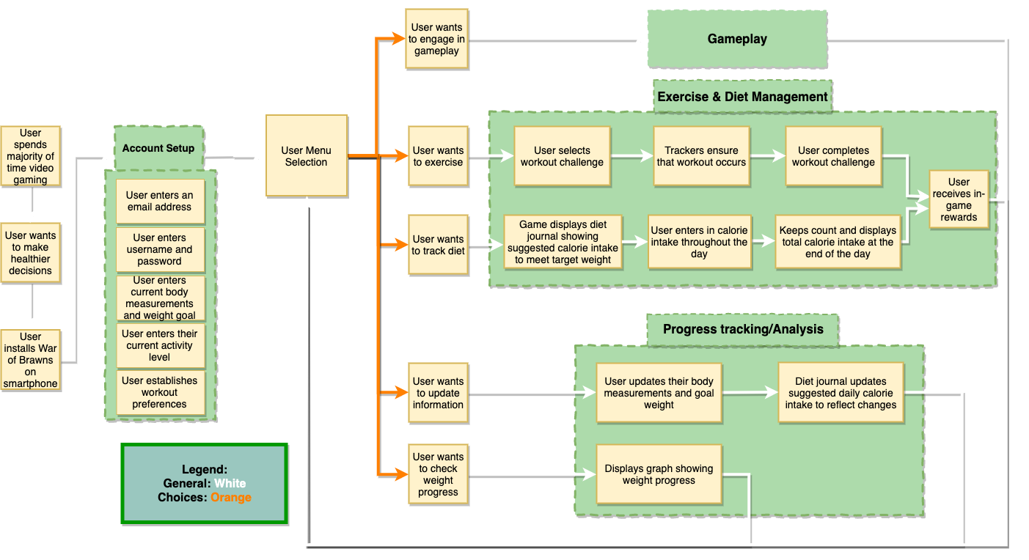
Solution Process Flow
CS 410 - Team Bronze | Fall 2019 | Old Dominion University
Notes:
Chris - progression? instant gratification? Describing myfitness apps
Need to add gameplay aspect to flow.
May add a second solution flow for that aspect
Add colored arrows to solution process flow
Maybe things like “set up”, “in-game”
Similar to problem process flow
Add yes or no arrows to outcomes
Mention account profile
Add another box that under account setup that says the user will be able to filter the type of workout challenges they are suggested.
Implement the legend from problem process flow onto the solution
MFCD interaction with players may need adjustments.
Think about things that could be tools such as packages, etc.
Today

Slide 15
User Roles
Gamer
Uses application to track exercise and diet
Track weight progression over time
Engages in gameplay
Administrator
Update and inform users on apps maintenance
Communicate amongst users
Directly access WoB Database to manually modify user data
CS 410 - Team Bronze | Fall 2019 | Old Dominion University
Notes:
Move developer role to dev tools possibly, leaving it here opens it to confusion and debate

Slide 16
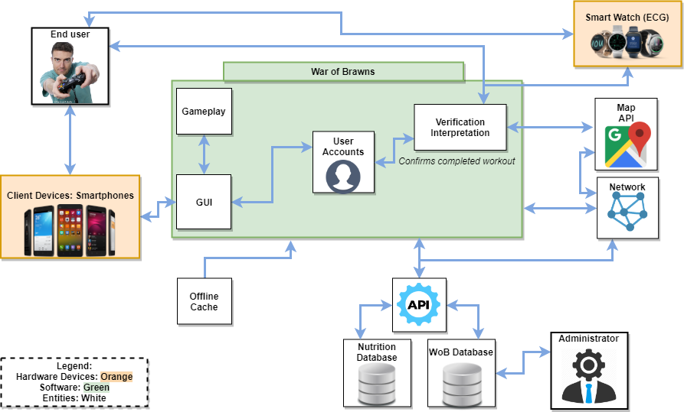
Major Functional Component Diagram
CS 410 - Team Bronze | Fall 2019 | Old Dominion University
Notes:
Chris - high cost to start
Introduce enhancement of motion camera similar to kinect but with the smartphone camera
MFCD interaction with players may need adjustments.
Think about things that could be tools such as packages, etc.
Today

Slide 17
Dev Tools, Hardware and Software Needs
Pre - Production Tools:
Google hangout
Google drive
Draw.io
Google calendar
Web Dev Tools:
Notepad++
Secure file transfer
WinSCP
Production Tools:
Unity (Game Development)
Visual Studio (UI/UX/Game Scripts)
Adobe Photoshop (Images)
Adobe Illustrator (Images)
Audacity (Audio Production)
Hardware Requirements:
Smartphone
Optional: Smartwatch
Operating system (OS) :
Android/iOS
3rd Party Software Needs:
ESHA Nutrition Database API
Smartwatch API
GPS API
App Stores
Database Software
Firebase
SQLDBM (Diagram Development)
CS 410 - Team Bronze | Fall 2019 | Old Dominion University
Notes:
Address developer stories here ? - professor comment
Note: reading too much off the slide

Slide 18
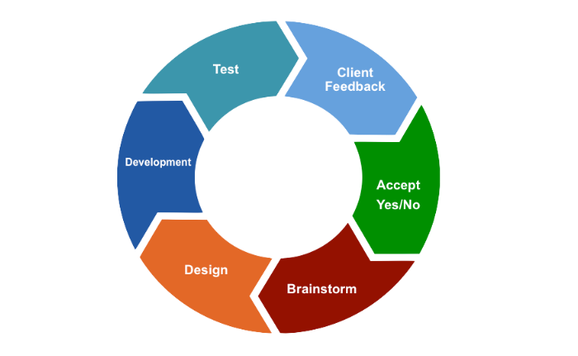
Agile Development Model
CS 410 - Team Bronze | Fall 2019 | Old Dominion University

Slide 19
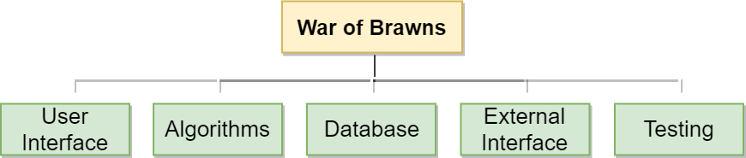
Work Breakdown Structure (WBS) Overview
CS 410 - Team Bronze | Fall 2019 | Old Dominion University

Slide 20
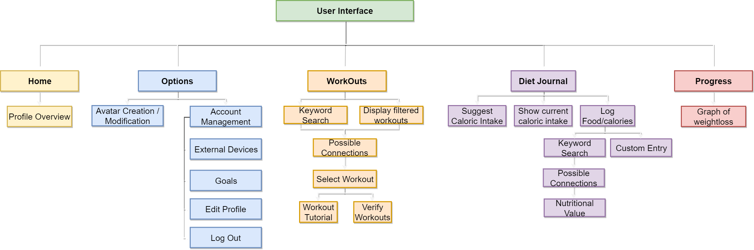
WBS - User Interface - Non Gameplay
CS 410 - Team Bronze | Fall 2019 | Old Dominion University
Notes:
Note: don’t need to go in so much detail for options (don’t read down the tree of the diagrams)

Slide 21
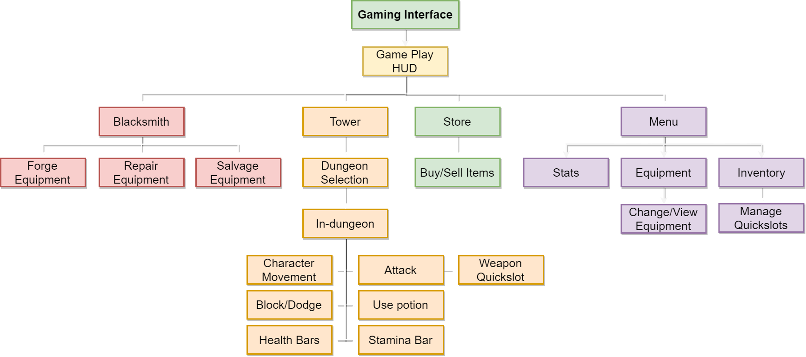
WBS - User Interface - Gameplay
CS 410 - Team Bronze | Fall 2019 | Old Dominion University

Slide 22
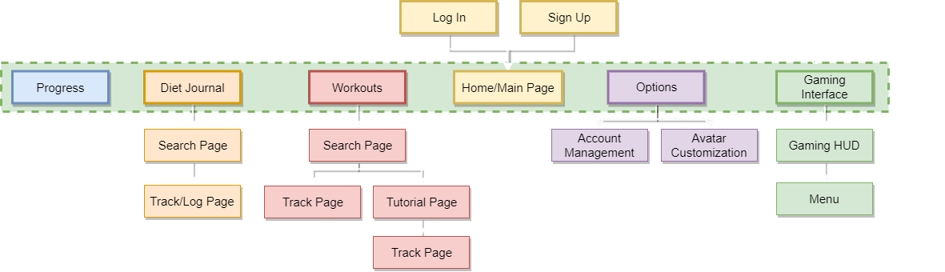
User Interface - Site map
CS 410 - Team Bronze | Fall 2019 | Old Dominion University

Slide 23
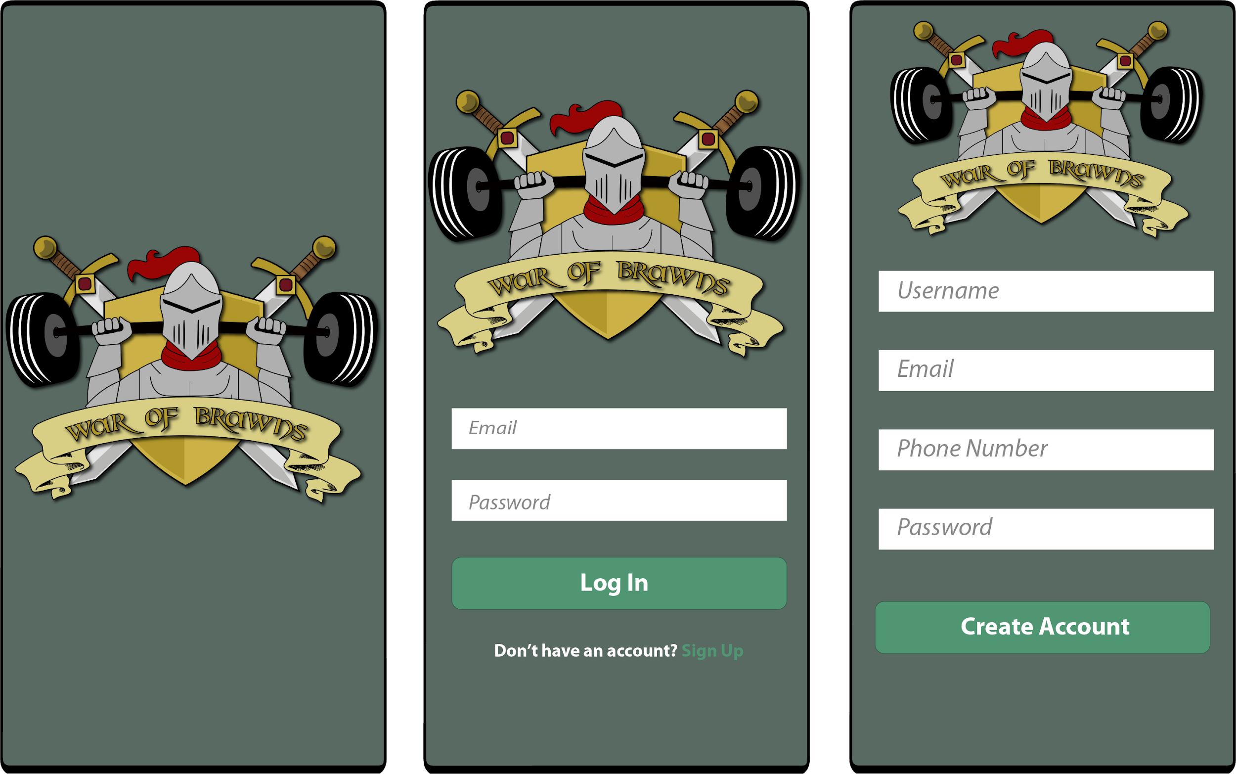
GUI Mockup - Account Creation
Startup Screen
Log In Screen
Account Creation
CS 410 - Team Bronze | Fall 2019 | Old Dominion University

Slide 24
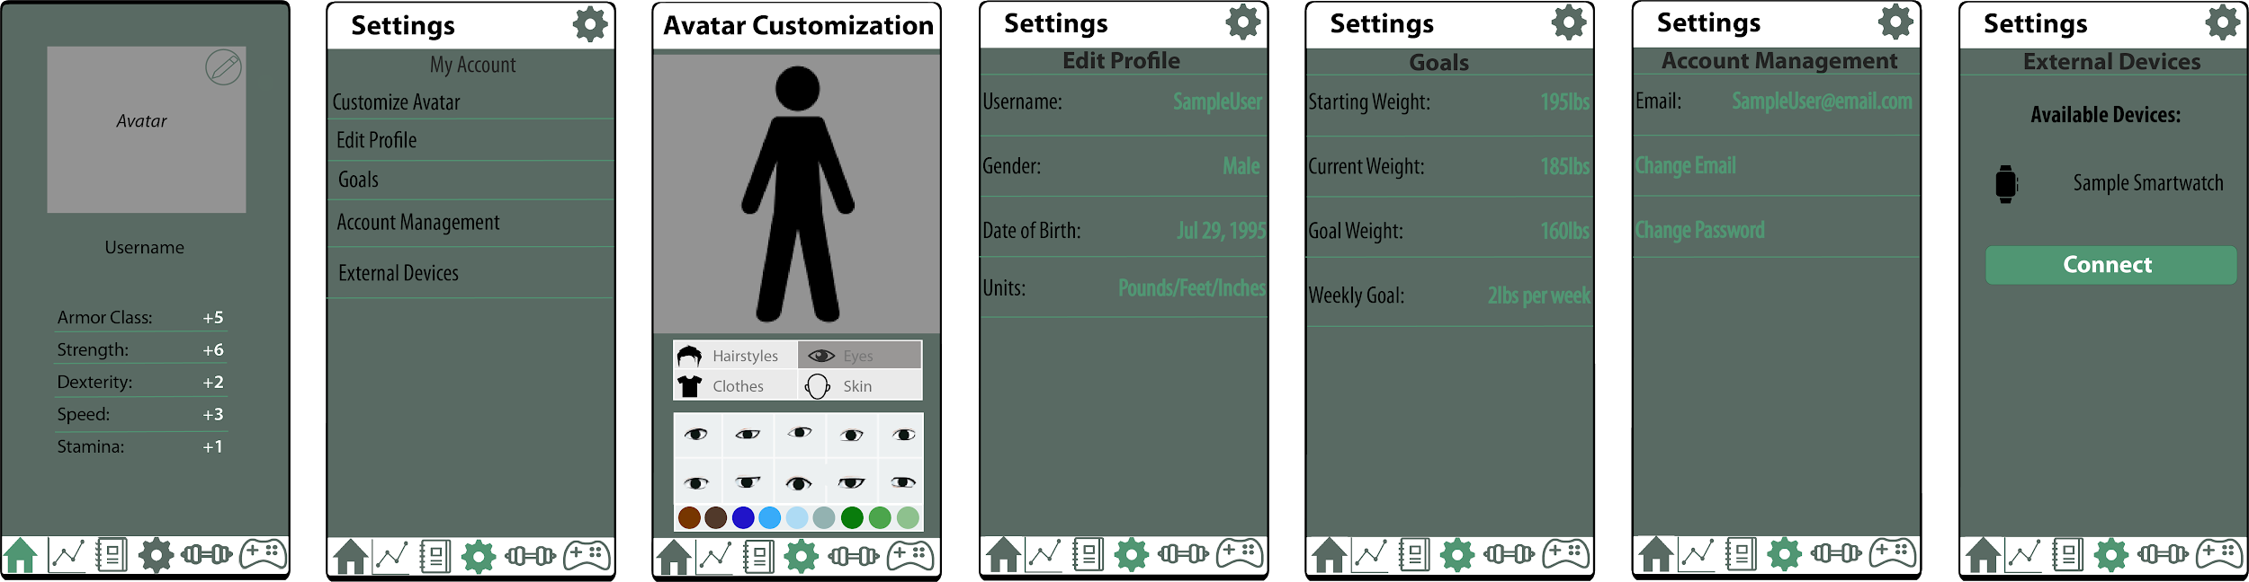
GUI Mockup - Settings
Home Page
Settings Page
Avatar Customization
Edit Profile - Tap to edit
Goals-
Tap to edit
Account Management
Connecting External Devices
CS 410 - Team Bronze | Fall 2019 | Old Dominion University

Slide 25
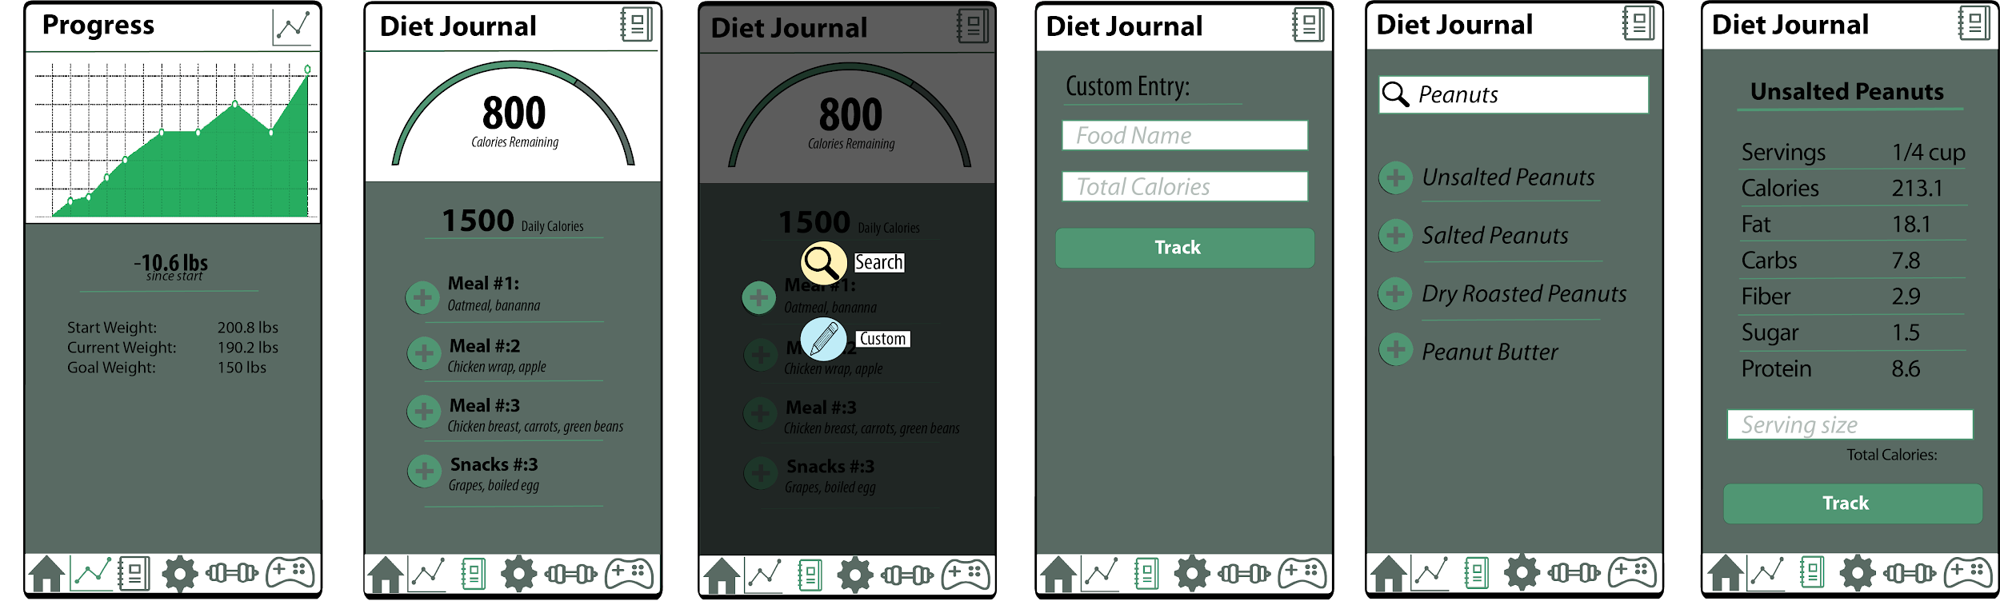
GUI Mockup - Progress & Diet Journal
Progress Page
Diet Journal
Options to add a food
Custom Food Entry
Food Search
Tracking Searched food
CS 410 - Team Bronze | Fall 2019 | Old Dominion University

Slide 26
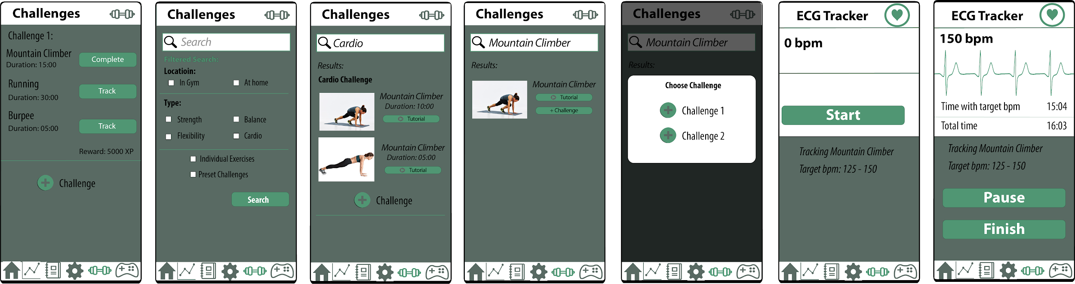
GUI Mockup - Challenges
Challenges Page
Filter search Challenges
Add preset challenge
Challenges Selection
Add to specific challenge
During tracking
Finish Tracking
CS 410 - Team Bronze | Fall 2019 | Old Dominion University

Slide 27
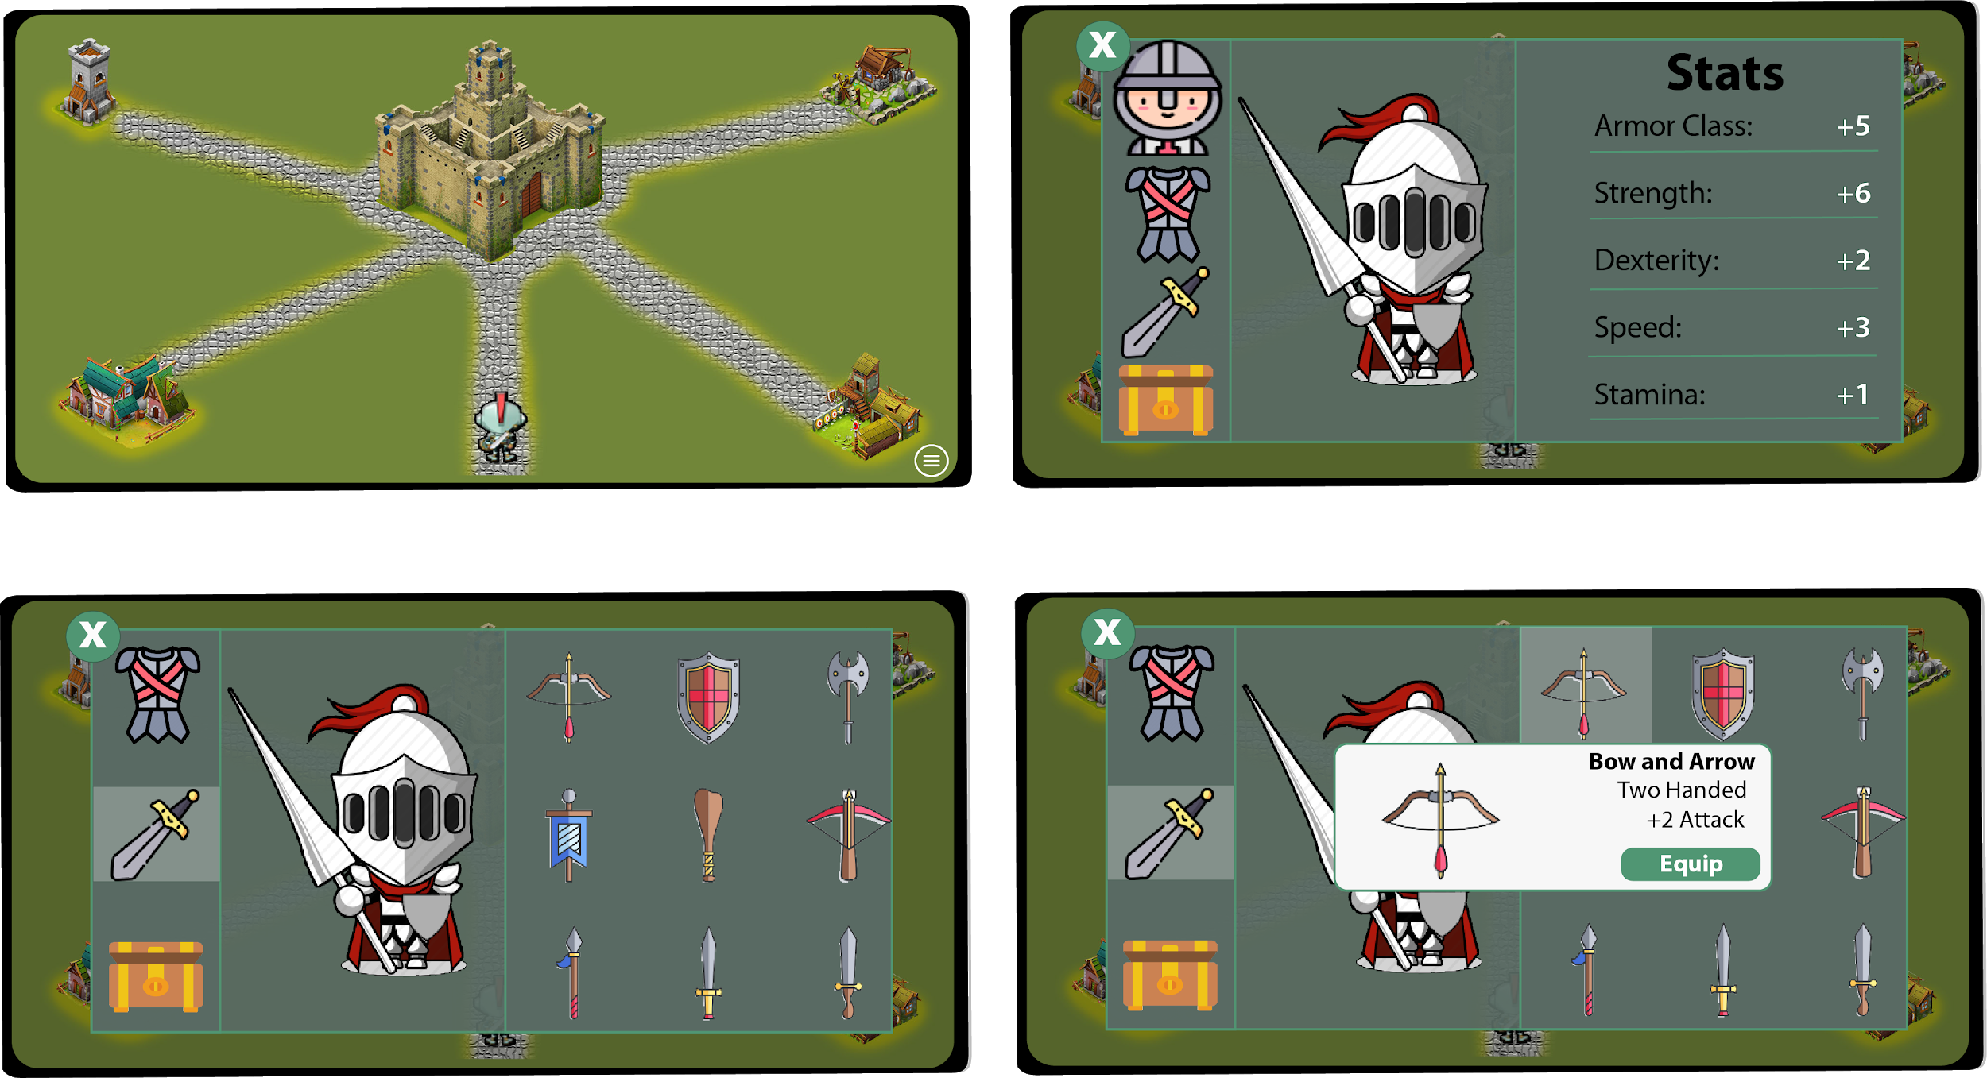
GUI Mockup - In-Game Menu
In Town
Main Menu
Weapons
Tap to equip Weapons
Hold down to add to quick slots
CS 410 - Team Bronze | Fall 2019 | Old Dominion University

Slide 28
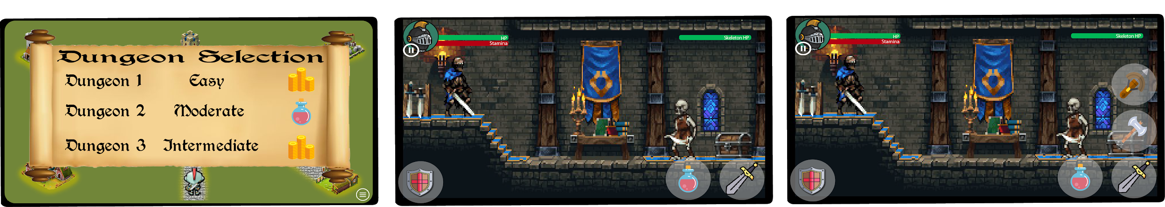
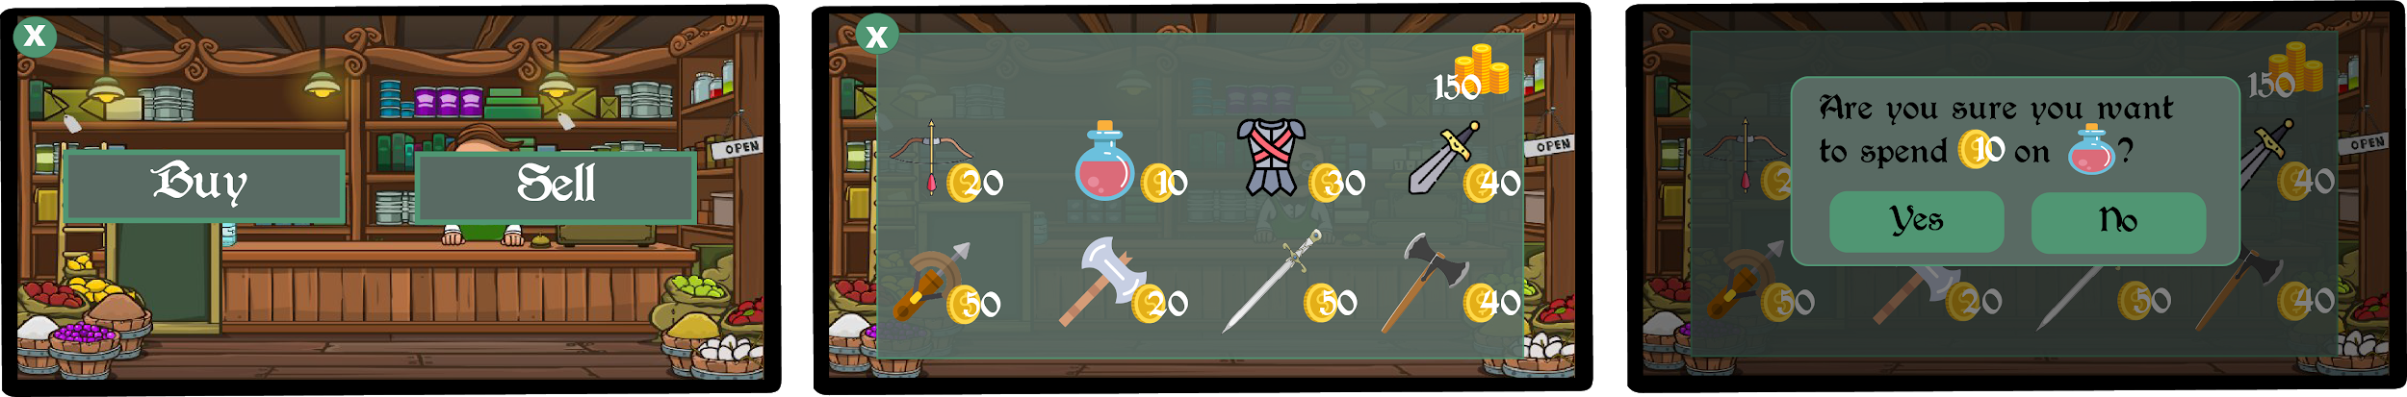
GUI Mockup - In-Game Dungeon and Store
Dungeon Selection In-Combat Hold Attack for access to quickslots
Store Options for buying Verify action
CS 410 - Team Bronze | Fall 2019 | Old Dominion University

Slide 29
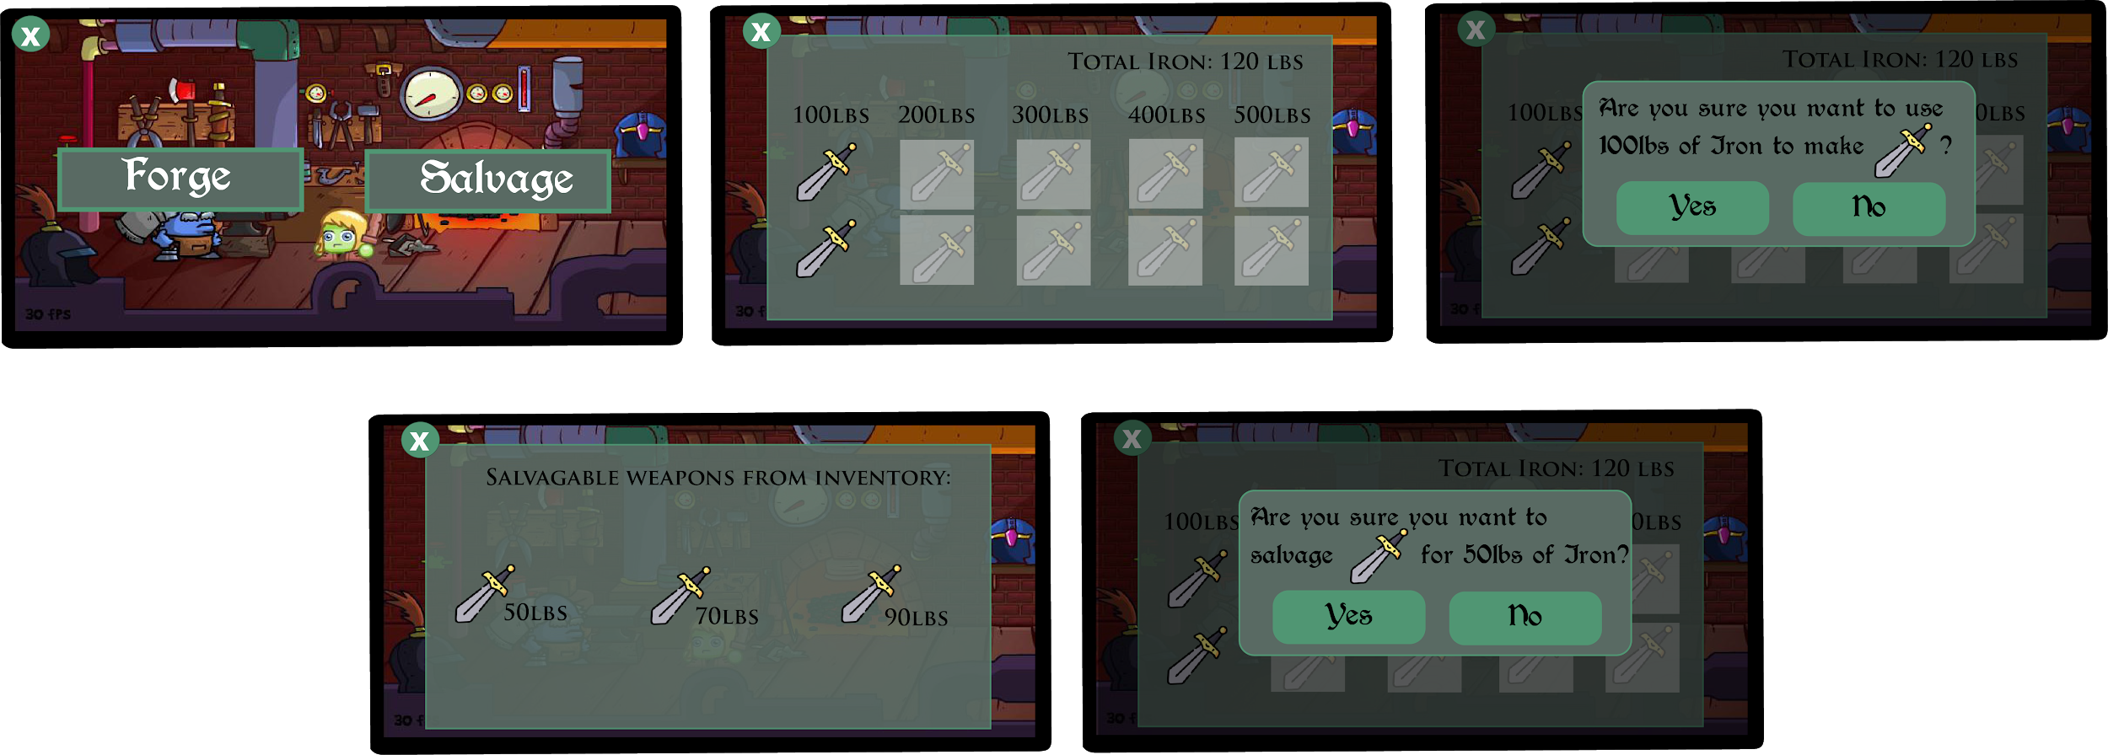
GUI Mockup - In-Game Blacksmith
Blacksmith Forging selection - Greyed if unavailable Verify action
Salvage option Verify Action
CS 410 - Team Bronze | Fall 2019 | Old Dominion University

Slide 30
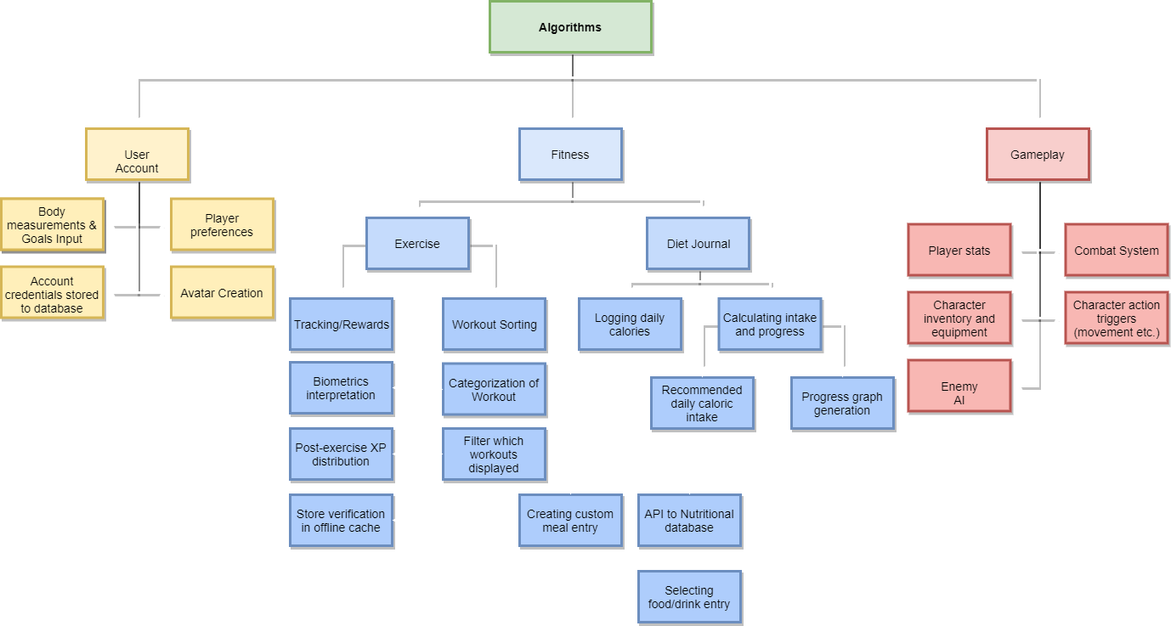
WBS - Algorithm
CS 410 - Team Bronze | Fall 2019 | Old Dominion University

Slide 31
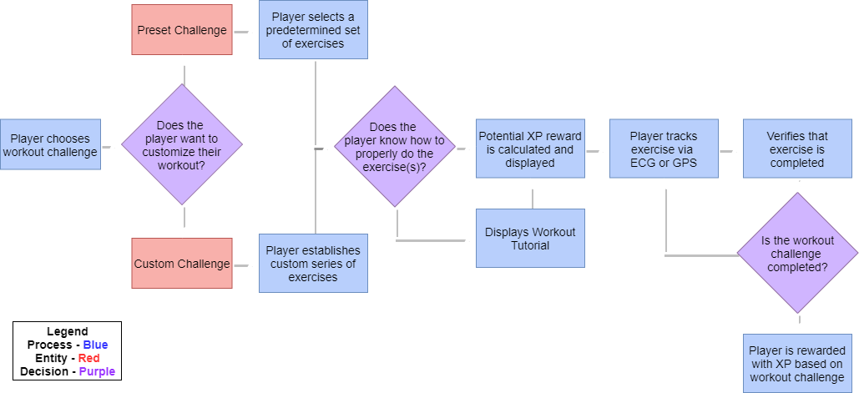
Exercise
CS 410 - Team Bronze | Fall 2019 | Old Dominion University

Slide 32
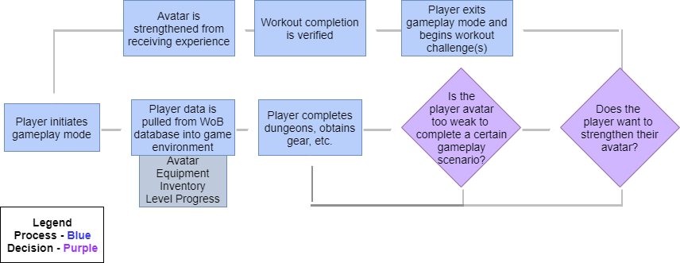
Gameplay
CS 410 - Team Bronze | Fall 2019 | Old Dominion University

Slide 33
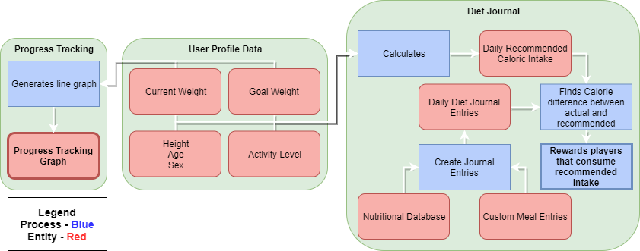
Diet Journal and Progress Checking
CS 410 - Team Bronze | Fall 2019 | Old Dominion University

Slide 34
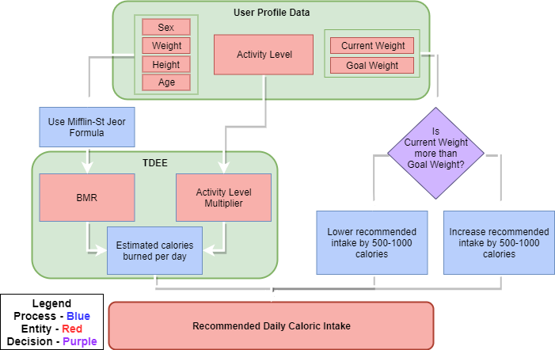
Daily Recommended Caloric Intake
CS 410 - Team Bronze | Fall 2019 | Old Dominion University

Slide 35
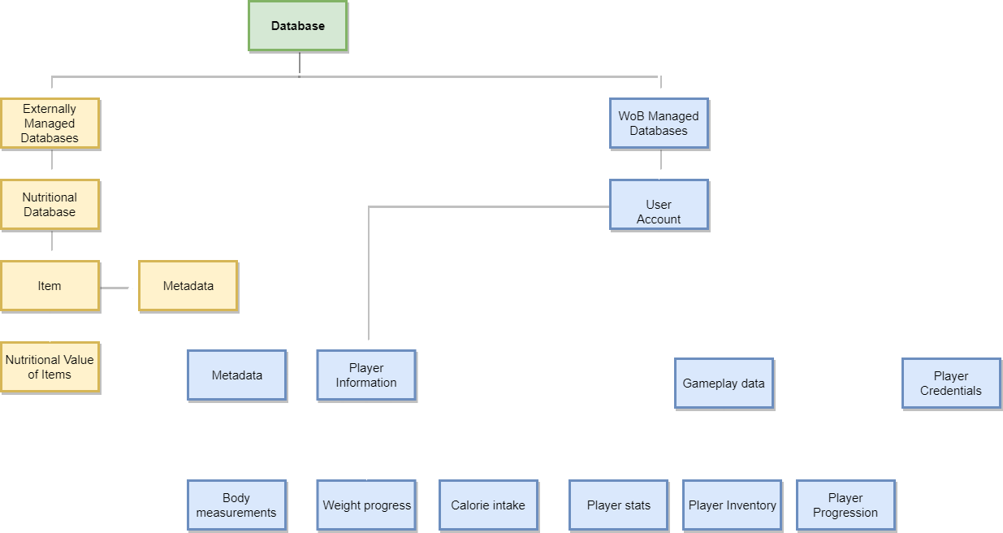
WBS - Database
CS 410 - Team Bronze | Fall 2019 | Old Dominion University
Notes:
Key Points: 2 databases - one external for nutritional information related to diet journal functionality (on left), one managed by WoB (firebase) for storing player information so they can carry their progress across devices if they choose to

Slide 36
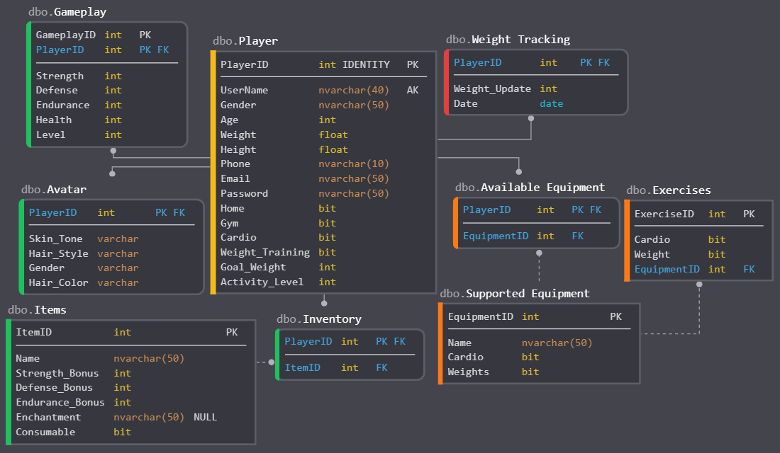
WoB Database Schema
CS 410 - Team Bronze | Fall 2019 | Old Dominion University
Notes:
Key points: almost all information stored here is directly tied to a player (exceptions are the item table, supported equipment table, and exercises table). Plan on storing information about player stats (gameplay), avatar, inventory, and weight updates so their progress on their weight loss journey can be represented to them to show whether they are making good progress or not.

Slide 37
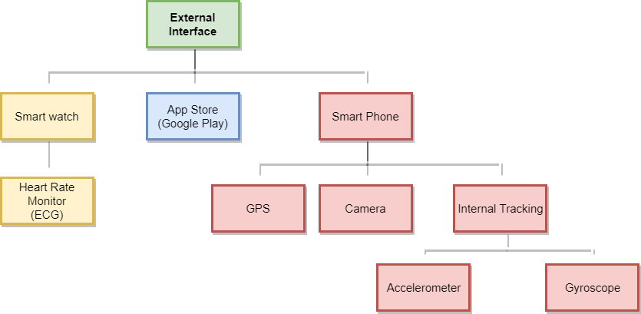
WBS - External Interface
CS 410 - Team Bronze | Fall 2019 | Old Dominion University
Notes:
Key points: External interfaces include smart watch (Heart rate monitor for exercise tracking), app store (google play for example), and their smart phone which should include gps, camera, and internal tracking mechanisms for future updates to make tracking more convenient to the user

Slide 38
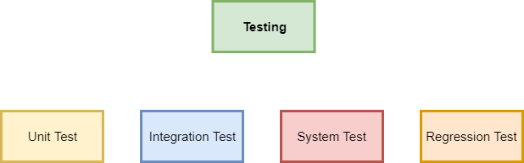
WBS - Testing
CS 410 - Team Bronze | Fall 2019 | Old Dominion University
Notes:
Key points: testing involves the 4 basic testing categories for software development. Unit testing for individual components, integration testing for testing of components working together, system testing for making sure the entire system works with all the components intact, and regression testing for when we change components in future updates.

Slide 39
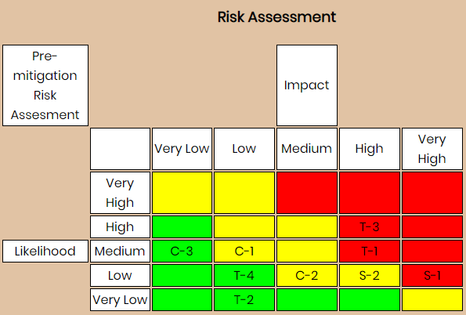
Risk Matrix and Mitigation Strategies
Technical Risks:
T-1: The server is unable to handle the database usage as the user base grows, performance degrades
T-2: App suggests incorrect caloric intake to meet goal weight
T-3: App loses connection the Internet
T-4: Smartwatch loses bluetooth connection to smartphone
Security Risks:
S-1: Database security breach
S-2: Unauthorized access to the database
Mitigation Strategies:
T-1: Implement a scalable architecture for our app to handle user growth.
T-2: Verify caloric intake suggestions and perform tests on the software to ensure it has the right value.
Also provide a disclaimer stating that advice given in the app does not constitute proper medical advice.
T-3: Data would be saved to the offline cache to be uploaded later when Internet connection is restored.
T-4: App would show a pop-up warning that notifies the user of disconnection.
S-1: Keep up-to-date modern encryption methods.
S-2: Password protected login authentication feature offered through Firebase
CS 410 - Team Bronze | Fall 2019 | Old Dominion University
Notes:
Key Points: 3 types of risks we foresee (technical, security, customer) [speak to what the risks are]
Got rid of “T-2: App suggests incorrect caloric intake to meet goal weight”.
Got rid of “ T-2: Verify caloric intake suggestions and perform tests on the software to ensure it has the right value. Also provide a disclaimer stating that advice given in the app does not constitute proper medical advice.”
Note: also need to change the risk matrix picture for loss of T-2.
Added “and apply concept of gaming addiction to keep users interested.” to C-2 Mitigation. To use the concept of gaming addiction to keep users entertained.

Slide 40
Risk Matrix and Mitigation Strategies Continued
Customer Risk:
C-1: User falsified information which leads to unwanted results
C-2: Customer becomes disinterested in the app?
C-3: Customer’s established impossible goals
Mitigation Strategies:
C-1: Trackers for exercise and warn users that false information will impede their ability to use the app effectively
C-2: Add surveys asking for feedback and recommendations from user base to continuously improve aspects of the game.
C-3: App will test the established goals against a parameters to test if achievable.
CS 410 - Team Bronze | Fall 2019 | Old Dominion University
Notes:
Got rid of “T-2: App suggests incorrect caloric intake to meet goal weight”.
Got rid of “ T-2: Verify caloric intake suggestions and perform tests on the software to ensure it has the right value. Also provide a disclaimer stating that advice given in the app does not constitute proper medical advice.”
Note: also need to change the risk matrix picture for loss of T-2.
Added “and apply concept of gaming addiction to keep users interested.” to C-2 Mitigation. To use the concept of gaming addiction to keep users entertained.

Slide 41
Sprint Breakout
Sprint | Weeks | Focus | Description
1 | 1 | Review and Designate | Review design, designate and clarify roles, determine which elements of the program will need to be simulated for prototype
2 | 1-2 | Environment Setup | Develop building blocks of the application (user sign-in, profile creation) and layout the database following developed schema
3 | 2-3 | UI/UX | Create the UI/UX elements, make sure ECG tracking data is being sent to the application
4 | 1-2 | Level Design | Design levels (home base, dungeon, etc.) and user interaction for the gameplay
5 | 2 | Algorithms | Algorithms for exercise detection and reward distribution developed, make sure results are stored to database
6 | 2 | Database Finalization | Database finalized, fully integrate the algorithms into the gameplay experience, begin system testing
7 | 2 | System Integration | Integration testing, tweaking as necessary. All unit tests should be passing, system testing should reflect functional requirements
CS 410 - Team Bronze | Fall 2019 | Old Dominion University
Notes:
Key Points: 7 sprints, go over the sprint focuses

Slide 42
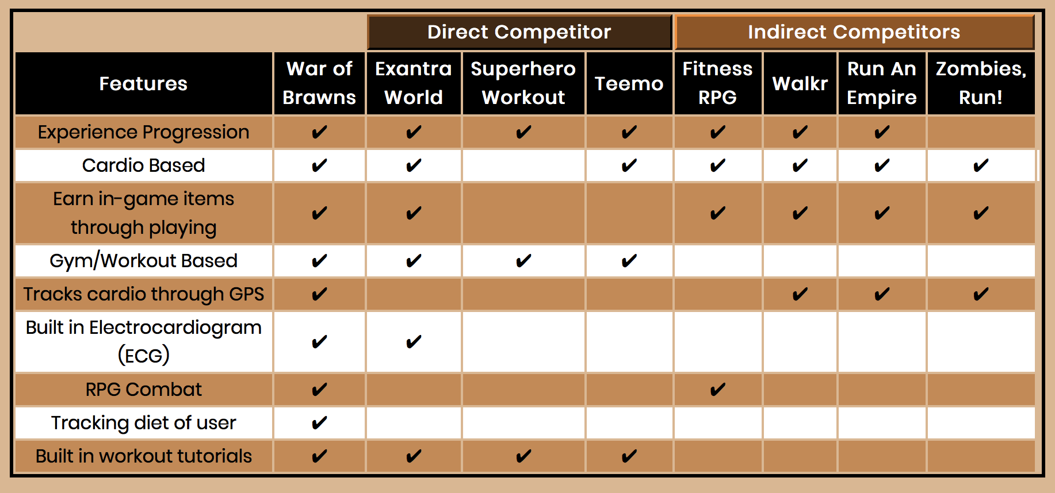
Competition Matrix
CS 410 - Team Bronze | Fall 2019 | Old Dominion University
Notes:
Key Points: go over main features, difference between direct and indirect competitors. Address main competitor (exantra) and differentiate us from them

Slide 43
Benefits to Customer Base
Adds a fun aspect to exercising
Provides motivation to exercise
Tracks diet intake
Establishes a path towards goal
Establishes an alternative lifestyle around the user’s game addiction
CS 410 - Team Bronze | Fall 2019 | Old Dominion University
Notes:
Key Points: helps to make exercise more enjoyable, provides motivation to exercise that otherwise might not have existed, helps the user keep track of their dietary habits, establishes a path towards the user’s goal (whether that is losing weight or just becoming more active), and establishes an alternative lifestyle around the user’s game addiction

Slide 44
Conclusion
Gaming addiction is a real issue
Currently no innovative solution to gaming addiction
Use gaming addiction as a pathway to healthy living
We want you to get addicted to fitness
CS 410 - Team Bronze | Fall 2019 | Old Dominion University
Notes:
In conclusion, gaming addiction is a real issue that has yet to see an innovative solution. Our goal is to use War of Brawns to create a pathway through gaming addiction to a healthy lifestyle. We want you to get addicted to fitness.
Some of the reference links don’t work.

Slide 45
Questions?
CS 410 - Team Bronze | Fall 2019 | Old Dominion University

Slide 46
References
Conrad, B. (n.d.). 15 Reasons & Theories on Why Video Games Are Addictive. Retrieved October 8, 2019, from http://www.techaddiction.ca/why_are_video_games_addictive.html.
DNPAO Data, Trends and Maps: Explore by Topic. (n.d.). Retrieved October 30, 2019, from https://nccd.cdc.gov/dnpao_dtm/rdPage.aspx?rdReport=DNPAO_DTM.ExploreByTopic&islClass=PA&islTopic=PA1&go=GO.
Ellis, M. (2018, October 2). Gamified Fitness Apps That Make Working Out Fun. Retrieved October 8, 2019, from https://stylefox.co/gamified-fitness-apps-that-make-working-out-fun/.
Exantra World: Fitness RPG (Role Playing Game). (2019, September 29). Retrieved October 8, 2019, from https://www.kickstarter.com/projects/altertitan/exantra-world-fitness-rpg-role-playing-game.
Find your best self with our favorite health and fitness apps for Android. (2018, December 21). Retrieved October 8, 2019, from https://www.digitaltrends.com/mobile/best-fitness-apps-for-android/.
Gaming Addiction Statistics. (2019, September 26). Retrieved October 8, 2019, from https://www.therecoveryvillage.com/process-addiction/video-game-addiction/gaming-addiction-statistics/#gref.
Hu, F. B. (n.d.). Sedentary lifestyle and risk of obesity and type 2 diabetes. Retrieved October 8, 2019, from https://link.springer.com/article/10.1007/s11745-003-1038-4.
Hull, M. (2019, November 25). Video Game Addiction. Retrieved December 12, 2019, from https://www.therecoveryvillage.com/process-addiction/video-game-addiction/#gref.
CS 410 - Team Bronze | Fall 2019 | Old Dominion University

Slide 47
References Continued
Ivanova, I. (2019, May 28). World Health Organization makes "gaming disorder" a medical addiction. Retrieved October 8, 2019, from https://www.cbsnews.com/news/world-health-organization-makes-gaming-disorder-a-medical-diagnosis-of-addicition/.
Kravitz, L. (n.d.). Exercise Motivation: What Starts and Keeps People Exercising? Retrieved October 8, 2019, from https://www.unm.edu/~lkravitz/Article%20folder/ExerciseMot.pdf
Marrs, M. (2017, November 14). 6 Fitness Apps That Make Working Out Too Fun to Skip. Retrieved October 8, 2019, from https://www.lifehack.org/articles/lifestyle/6-fitness-apps-that-make-working-out-too-fun-skip.html.
Mastroianni, B. (2018, August 29). Turning Exercise Into a Game Can Make Fitness More Fun and Effective. Retrieved October 8, 2019, from https://www.healthline.com/health-news/turning-exercise-into-a-game-can-make-fitness-more-fun-and-effective
Teemo. (n.d.). Retrieved October 8, 2019, from https://goteemo.com/.
Video Game Addiction Treatment for Teens. (n.d.). Retrieved October 8, 2019, from https://elkrivertreatment.com/treatment/treating-teen-video-game-addiction/.
Watkins, M. (2019, June 13). Video Game Addiction Symptoms and Treatment. Retrieved October 30, 2019, from https://americanaddictioncenters.org/video-gaming-addiction
CS 410 - Team Bronze | Fall 2019 | Old Dominion University

Slide 48
Glossary
Basal Metabolic Rate (BMR) - The number of calories required to keep the body functioning at rest. Essentially, how many calories are burned in a day not including physical activity.
Electrocardiogram (ECG) - A test that measures the electrical activity of the heartbeat. With each beat, an electrical impulse (or “wave”) travels through the heart.
Experience Points (XP) - A unit of measurement to quantify an avatar’s progression through a game. Once a sufficient amount of experience points are accumulated, the player or a certain statistic “levels up”. The higher the level, the stronger the avatar.
Game Artificial Intelligence (AI) - Artificial intelligence is used to generate responsive, adaptive or intelligent behaviors primarily in non-player characters similar to human-like intelligence.
Game Avatar - A personalized graphical illustration that represents a computer user, or a character or alter ego that represents that user.
CS 410 - Team Bronze | Fall 2019 | Old Dominion University

Slide 49
Glossary Continued
Gaming Disorder - Pattern of persistent or recurrent gaming behavior in which people lose control of their gaming behavior, give priority to gaming over other interests and activities, and continue gaming despite negative consequences, such as impairments in their family relationships, social lives, work duties or other areas.
Heads Up Display (HUD) - The display area where players can see their character's vital statistics such as current health, bonus attributes, armor level, ammunition count, and more.
Mifflin-St Jeor Formula - Formula that calculates BMR from age, sex, height, and weight
Role-playing Game (RPG) - Type of game in which players assume the roles of characters.
Total Daily Energy Expenditure (TDEE) - The total amount of calories burned in a day including basic body functions and physical activity
CS 410 - Team Bronze | Fall 2019 | Old Dominion University

Slide 50
Appendix A1 - User Stories (Gamer) - Need
As a gamer, I need to be able to select workout challenges so that I am doing exercises I want to do
As a gamer, I need to be able to create a gamer account to access app features
As a gamer, I need to be able to record my body measurements to calculate recommended daily caloric intake
As a gamer, I need to be able to record my goal weight for recommended caloric intake and progress tracking
As a gamer, I need to be able to set the activity level to calculate recommended daily caloric intake
As a gamer, I need to be able to progress in game through my character
As a gamer, I need to be able to cancel the workout challenge while in progress
As a gamer, I need to be able to fight in gameplay so that I can be engaged in the addictive features
As a gamer, I need to be able to set my favorite exercises or workout challenges for convenient accessibility
As a gamer, I need to be able to earn in game items to enhance and personalize my avatar
CS 410 - Team Bronze | Fall 2019 | Old Dominion University

Slide 51
Appendix A1 - User Stories (Gamer) - Need
Continued
As a gamer, I need to receive XP in certain stats after certain workout challenges to progress my character
As a gamer, I need to be able to track my caloric intake so that I can manage my dietary habits
As a gamer, I need to be able to update my body measurements to keep caloric algorithm accurate
As a gamer, I need to be able to update my goal weight for progress tracking and to keep recommended caloric intake accurate
As a gamer, I need to be able to save my information in settings to the database and be able to load it to maintain progress
As a gamer, I need to download War of Brawns through my app store so that I can access the app
As a gamer, I need to use War of Brawns on my Android or iOS
CS 410 - Team Bronze | Fall 2019 | Old Dominion University

Slide 52
Appendix A1 - User Stories (Gamer) - Want
As a gamer, I want to be able to delete my gamer account
As a gamer, I want to be able to set my preferences for workout challenges
As a gamer, I want to be able to customize my avatar to personalize my experience
As a gamer, I want to be able to equip in-game cosmetics to personalize my experience
As a gamer, I want to be able to search for workout challenges to easily find certain workouts
As a gamer, I want my avatar's body to be proportional to player stats for visual character progression
As a gamer, I want to utilize a smartphone camera to track workouts
As a gamer, I want to utilize a smartphone accelerometer to track workouts
CS 410 - Team Bronze | Fall 2019 | Old Dominion University

Slide 53
Appendix A2 - User Stories (Administrator)
As an administrator, I need to be able to update the WoB managed database, so that I can modify or ban accounts
As an administrator, I need to be able to make a backup of the database, so that I can revert to a previous version
As an administrator, I want to receive the gamers feedback through surveys in game so that we can make the game more enjoyable
As an administrator, I want to send out announcements for updates or maintenance to keep the users informed about changes
As an administrator, I want to be able to respond to user feedback, so that I can resolve any conflicts or concerns
CS 410 - Team Bronze | Fall 2019 | Old Dominion University

Slide 54
Appendix B1 - Developer Stories - Need
As a developer, I need to track the caloric intake of the gamer through a diet journal so that I can have the app recommend future diet practices
As a developer, I need to be able to let gamers login and logout so that they can continue their progress on different devices
As a developer, I need to access/store data to WoB managed database server so that there is a record of user accounts
As a developer, I need to design a variety of workout challenges, so that gamers can do workouts in different environments
As a developer, I need to design gameplay animations so that the gameplay is more engaging
As a developer, I need to design an interactive RPG gameplay system, so that users get addicted
As a developer, I need to display the animation of the gamers avatar so the gamer feels more attached to their avatar
As a developer, I need to verify completion with ECG data, so that the application is sure that gamers are actually working out
As a developer, I need to design the gamers interaction through GUI so that they have an intuitive control panel to play the game
As a developer, I need the diet journal to suggest a reasonable caloric intake to meet the gamers target goal weight
As a developer, I want to display the gamers stats, equipment, rewards, inventory through a menu so that they can see their progress and items
As a developer, I need the gamer to be able to search or select food from the database so that they can have nutritional information about their meals
CS 410 - Team Bronze | Fall 2019 | Old Dominion University

Slide 55
Appendix B1 - Developer Stories - Need Continued
As a developer, I need to record the players information through a WoB managed database
As a developer, I need to search for the nutritional data of food, so that the application and gamers can count calories efficiently
As a developer, I need to incorporate an offline cache that will hold the gamers information until network connection
As a developer, I need to record the verification of the gamers completed challenge in offline cache, so that gamers can workout offline and still progress
As a developer, I need to incorporate an API that can check the database for the items nutritional information
As a developer, I need to save the gamers gameplay progression in run time
As a developer, I need to set up an algorithm that allows the gamer to reset their password or email automatically.
As a developer, I need to be able to update the current version of the game to keep the game functioning optimally
As a developer, I need to track the gamers heartrate through a smartwatch with an API
As a developer, I need to track the gamers location through a GPS API
CS 410 - Team Bronze | Fall 2019 | Old Dominion University

Slide 56
Appendix B1 - Developer Stories - Want
As a developer, I want the gamer to be able to enter in their custom meal through the diet journal
As a developer, I want to incorporate a daily streak for the gamers progression through either workouts or the diet journal, so that there is a certain amount of commitment
As a developer, I want to implement a leaderboard to display the rankings of gamer base, so that gamers are more committed
As a developer, I want to filter the shown workout challenges based on gamers preference, so that gamers don't receive workout challenges not fit for their preferences
As a developer, I want to design reasonable RPG enemy AI, so that the game is difficult, but enjoyable
As a developer, I want to track the gamers weight progression through a line graph
As a developer, I want to include a workout tutorial for how exercises are properly done.
As a developer, I want to add a buff that can be gained from eating close to the recommended intake, so that there is an incentive for gamers to meet recommended intake
CS 410 - Team Bronze | Fall 2019 | Old Dominion University

